Slide 1


Faculty Development Program
On
ARTIFICIAL INTELLIGENCE & MACHINE LEARNING
5th – 9th February
Introduction to Machine Learning
By
Dr. Sibarama Panigrahi
Senior Member, IEEE
Assistant Professor, Department of Computer Sc. & Engineering
National Institute of Technology, Rourkela, Odisha, 769008, India
Mobile No.: +91-7377302566
Email: panigrahis[at]nitrkl[dot]ac[dot]in
panigrahi[dot]sibarama[at]gmail[dot]com

Slide 2
Outlines
Prerequisites (Linear Algebra)
Learning
Machine Learning (ML)
A loose taxonomy of ML
Supervised Learning
Unsupervised Learning
Reinforcement Learning
ML Perspective
Data and Features
Linear Regression
Logistic Regression
Performance Measures
Learning
Linear Algebra

Slide 3
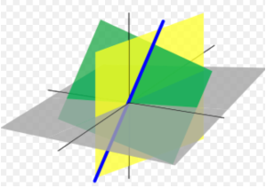
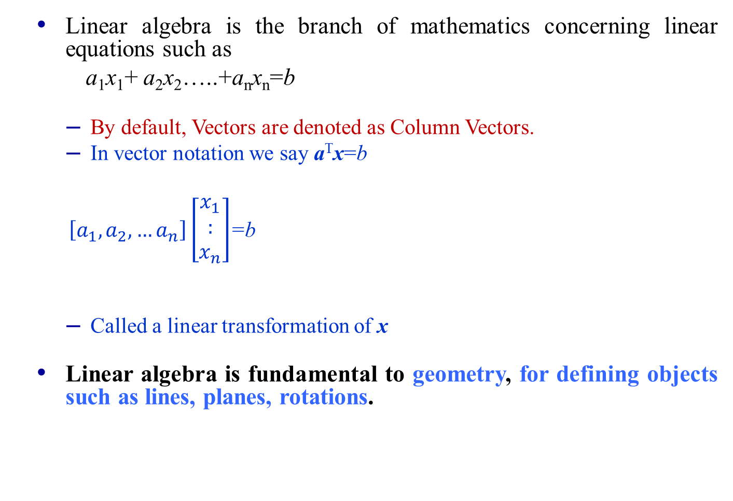
Linear Algebra
Linear algebra is the branch of mathematics concerning linear equations such as
a₁x₁+ a₂x₂…..+a_{n}x_{n}=b
By default, Vectors are denoted as Column Vectors.
In vector notation we say a^{T}x=b
$\left[a_{1},a_{2},…a_{n}\right]\left[\begin{matrix}x_{1} \\ : \\ x_{n}\end{matrix}\right]$=b
Called a linear transformation of x
Linear algebra is fundamental to geometry, for defining objects such as lines, planes, rotations.
Why Linear Algebra

Slide 4

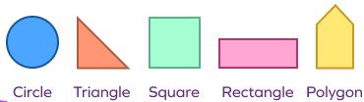
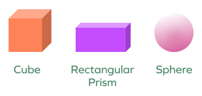
Why Linear Algebra?
Linear Algebra provides us the mathematical tool to understand in lower dimensions (2-D/3-D) and generalize for higher dimensions (n-D).
0-Dimensional : . (dot)
1-Dimensional
2-Dimensional
3-Dimensional
n-Dimensional: Hypersphere, Hyperplane, Hypercube,…
Point

Slide 5
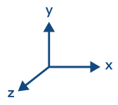
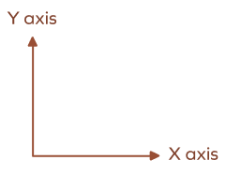
Point (Vector)
Component
P(a₁, a₂, a₃)
P(a₁, a₂)
2-Dimensional Space
3-Dimensional Space
P(a₁, a₂, a₃,… a_{n})
n-Dimensional Space
Distance Between Two Points

Slide 6
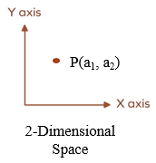
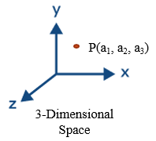
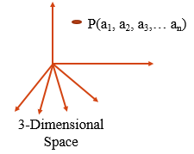
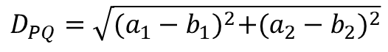
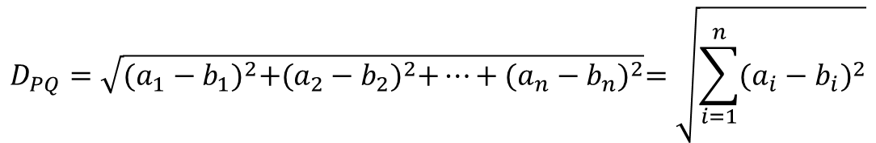
Distance between two Points
Q(b₁, b₂)
$$D_{PQ}=\sqrt{{(a_{1}−b_{1})}^{2}+{(a_{2}−b_{2})}^{2}}$$
Q(b₁, b₂, b₃)
$$D_{PQ}=\sqrt{{(a_{1}−b_{1})}^{2}+{(a_{2}−b_{2})}^{2}+{(a_{3}−b_{3})}^{2}}$$
Q(b₁, b₂, b₃,… b_{n})
$$D_{PQ}=\sqrt{{(a_{1}−b_{1})}^{2}+{(a_{2}−b_{2})}^{2}+…+{(a_{n}−b_{n})}^{2}}=\sqrt{\sum_{i=1}^{n}{{(a_{i}−b_{i})}^{2}}}$$
n
Dist of a Point from Origin

Slide 7
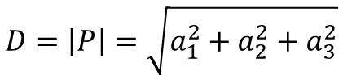
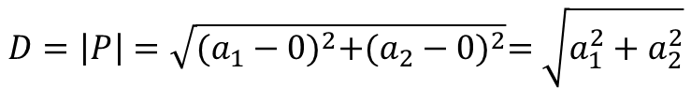
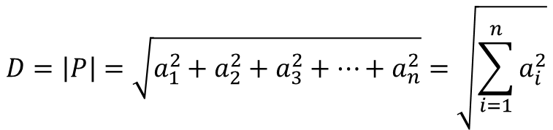
Distance of a Point from Origin
$$D=\left|P\right|=\sqrt{{(a_{1}−0)}^{2}+{(a_{2}−0)}^{2}}=\sqrt{a_{1}^{2}+a_{2}^{2}}$$
$$D=\left|P\right|=\sqrt{a_{1}^{2}+a_{2}^{2}+a_{3}^{2}}$$
$$D=\left|P\right|=\sqrt{a_{1}^{2}+a_{2}^{2}+a_{3}^{2}+…+a_{n}^{2}}=\sqrt{\sum_{i=1}^{n}{a_{i}^{2}}}$$
n
Vector Operation

Slide 8
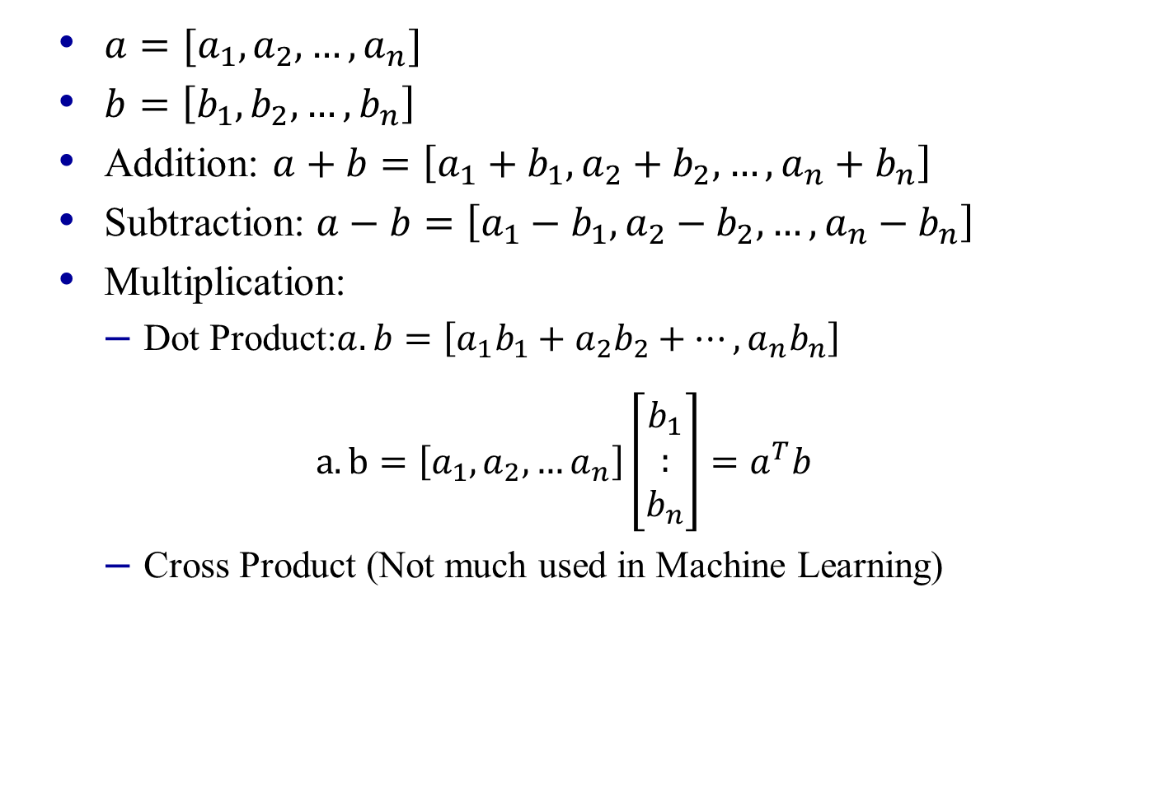
Vector Operations
$a=[a_{1},a_{2},…,a_{n}]$
$b=\left[b_{1},b_{2},…,b_{n}\right]$
Addition: $a+b=\left[a_{1}+b_{1},a_{2}+b_{2},…,a_{n}+b_{n}\right]$
Subtraction: $a−b=\left[a_{1}−b_{1},a_{2}−b_{2},…,a_{n}−b_{n}\right]$
Multiplication:
Dot Product:$a.b=\left[a_{1}b_{1}+a_{2}b_{2}+…,a_{n}b_{n}\right]$
$a.b=\left[a_{1},a_{2},…a_{n}\right]\left[\begin{matrix}b_{1} \\ : \\ b_{n}\end{matrix}\right]=a^{T}b$
Cross Product (Not much used in Machine Learning)
Dot Product in 2-D

Slide 9
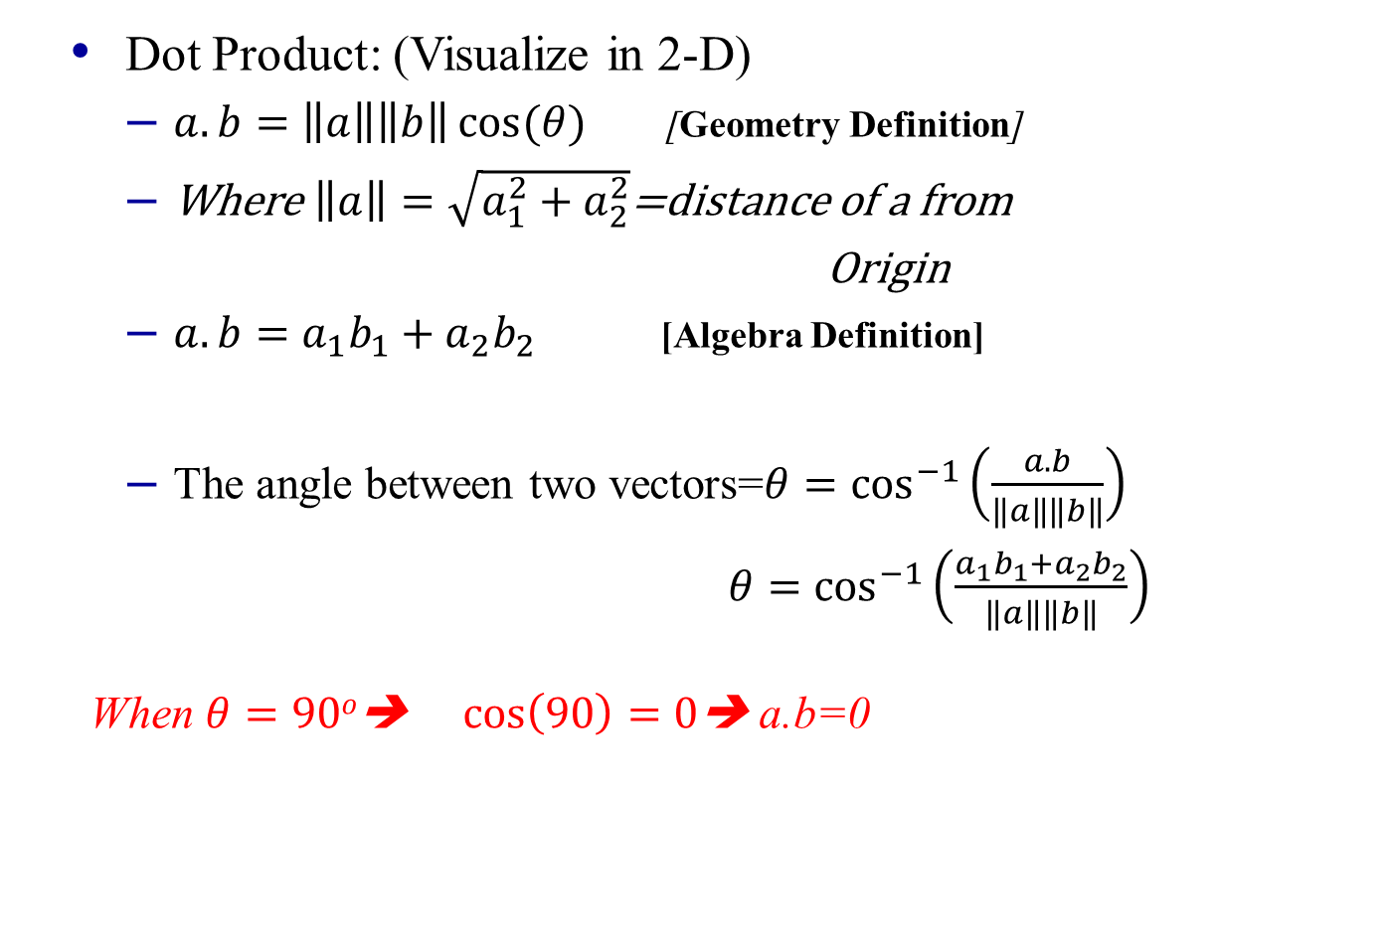
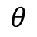
Vector Operations
Dot Product: (Visualize in 2-D)
$a.b=\left\|a\right\|\left\|b\right\|\cos{(θ)}$ [Geometry Definition]
Where $\left\|a\right\|=\sqrt{a_{1}^{2}+a_{2}^{2}}$=distance of a from
Origin
$a.b=a_{1}b_{1}+a_{2}b_{2}$ [Algebra Definition]
The angle between two vectors=$θ=\cos^{−1}\left(\frac{a.b}{\left\|a\right\|\left\|b\right\|}\right)$
$θ=\cos^{−1}\left(\frac{a_{1}b_{1}+a_{2}b_{2}}{\left\|a\right\|\left\|b\right\|}\right)$ When $θ=90o$➔ $\cos\left(90\right)=0$➔ a.b=0
a(a₁, a₂)
||a||
b(b₁, b₂)
$$θ$$
||b||
Dot Product in n-D

Slide 10
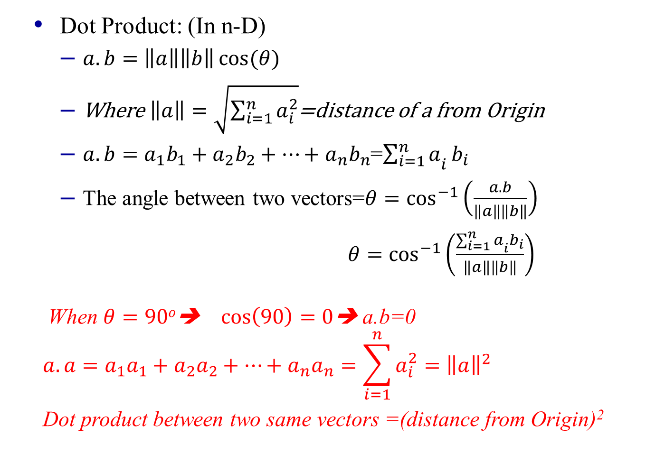
Vector Operations
Dot Product: (In n-D)
$a.b=\left\|a\right\|\left\|b\right\|\cos{(θ)}$
Where $\left\|a\right\|=\sqrt{\sum_{i=1}^{n}{a_{i}^{2}}}$=distance of a from Origin
$a.b=a_{1}b_{1}+a_{2}b_{2}+…+a_{n}b_{n}$=${\sum_{i=1}^{n}{a}}_{i}b_{i}$
The angle between two vectors=$θ=\cos^{−1}\left(\frac{a.b}{\left\|a\right\|\left\|b\right\|}\right)$
$θ=\cos^{−1}\left(\frac{{\sum_{i=1}^{n}{a}}_{i}b_{i}}{\left\|a\right\|\left\|b\right\|}\right)$ When $θ=90o$➔ $\cos\left(90\right)=0$➔ a.b=0
$$a.a=a_{1}a_{1}+a_{2}a_{2}+…+a_{n}a_{n}=\sum_{i=1}^{n}{a_{i}^{2}}={\left\|a\right\|}^{2}$$
Dot product between two same vectors =(distance from Origin)²
Line, Plane,…

Slide 11
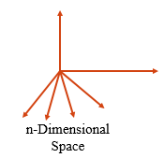
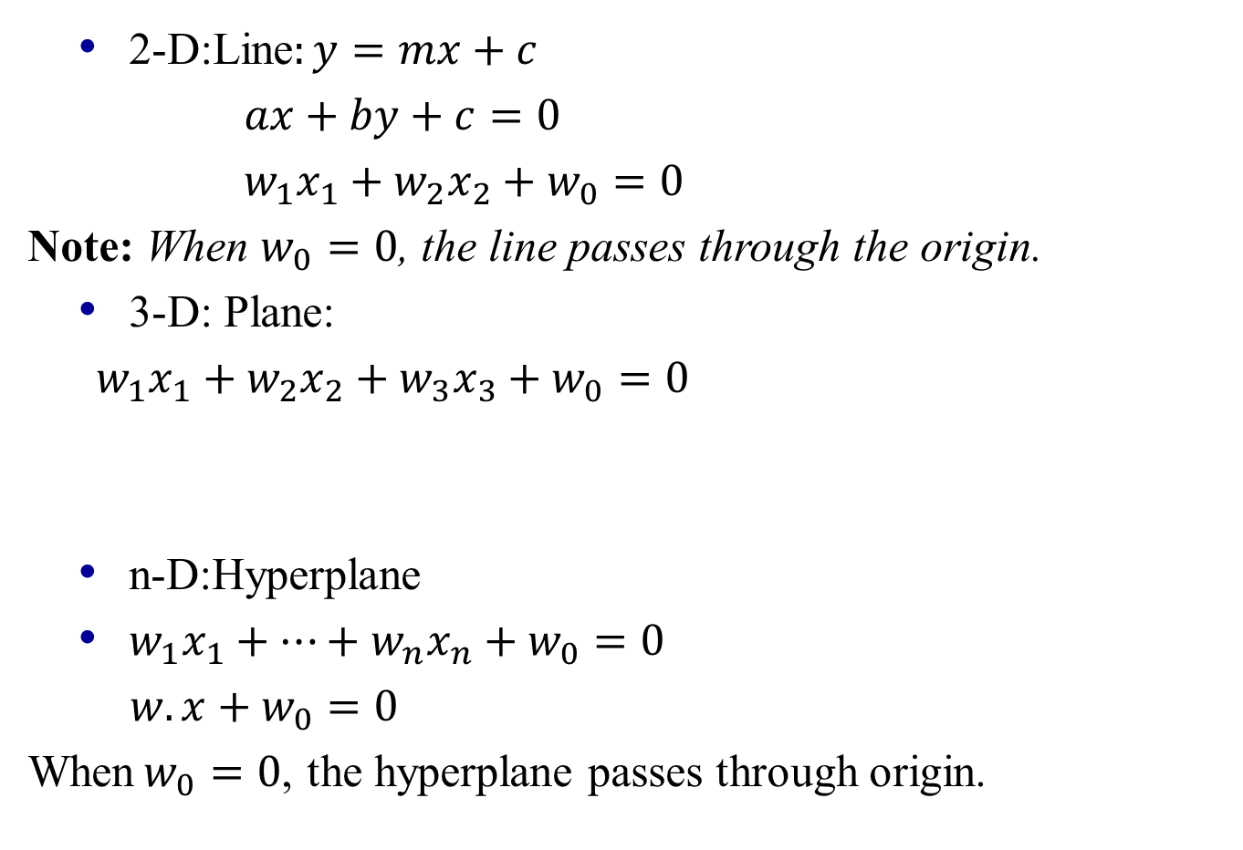
Line (2-D), Plane (3-D) & Hyperplane(n-D)
2-D:Line$:y=mx+c$
$ax+by+c=0$
$w_{1}x_{1}+w_{2}x_{2}+w_{0}=0$
Note: When $w_{0}=0$, the line passes through the origin.
3-D: Plane:
$w_{1}x_{1}+w_{2}x_{2}+w_{3}x_{3}+w_{0}=0$
n-D:Hyperplane
$w_{1}x_{1}+…+w_{n}x_{n}+w_{0}=0$
$w.x+w_{0}=0$
When$w_{0}=0$, the hyperplane passes through origin.
c
Interpretation

Slide 12
Line (2-D), Plane (3-D) & Hyperplane(n-D)
A plane breaks a plane into two half-spaces one
above the plane and one below the plane
If the dot product of plane (w) and point (p)
is positive then the point p is lying in the same
half plane as that of w otherwise it is lying in
the other half plane (i.e. opposite direction to w)
IRIS Dataset

Slide 13
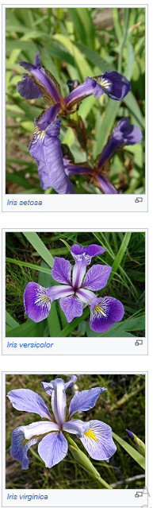
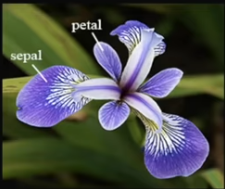
IRIS Flower Dataset
Iris Dataset: https://en.wikipedia.org/wiki/Iris_flower_data_set
Dataset is collected in 1936 by Ronald Fisher.
3 flowers of Iris species.
50 flowers of each class. Total 150 flowers.
Petal (length & width) and Sepal (length & width)
Setosa
Versicolor
Width
Length
Virginica
Objective
Objective

Slide 14
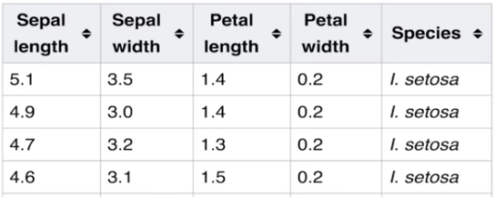
IRIS Flower Dataset
Iris Dataset: https://en.wikipedia.org/wiki/Iris_flower_data_set
Petal (length & width) and Sepal (length & width)
Objective: Classify a new flower as belonging to one of the 3 classes given the 4 features.
Setosa
Instance/ Object
Versicolor
Each Column is a Feature/ Attribute
4 input (independent) features, 1 target (dependent) class label
Virginica
2-D Scatter plot
2-D scatter Plot

Slide 15
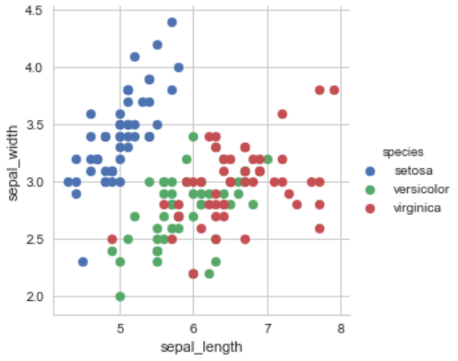
2-D Scatter Plot with Color Coding
Observations:
Using sepal_length and sepal_width features, we can distinguish Setosa flowers from others. [Linearly Separable]
Seperating Versicolor from Viginica is much harder as they have considerable overlap.
3d scatter plots in Python (plotly.com)
3-D Scatter plot
Learning

Slide 16
Learning
Learning = Improving with experience at some task
Improve over task T
with respect to performance measure P
based on experience E
E.g.
Task T = Predicting the Gender of a Person from a Photo
Performance measure=Classification Accuracy
Experience E
Machine Learning
Machine Learning

Slide 17
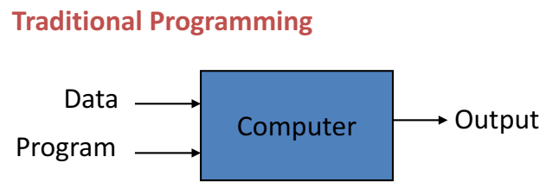
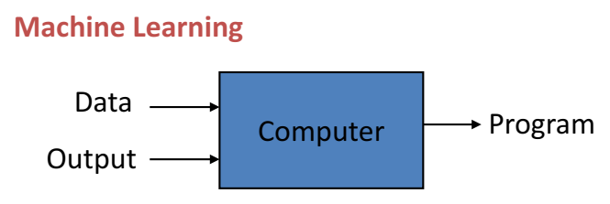
Machine Learning (ML)
“field of study that gives computers the ability to learn without being explicitly programmed” (Samuel 1959)
Taxonomy of ML
Taxonomy of ML

Slide 18
A Loose Taxonomy of ML
Learning using labeled data
Learning using unlabeled data
Some examples of
supervised
learning problems:
Classification
Regression
Ranking
Supervised
Learning
Some examples of
unsupervised learning
Problems:
Clustering
Dimensionality Reduction
Unsupervised
Learning
Machine Learning
Many other specialized flavors of ML also exist, some of which include
Semi-supervised Learning
Transfer Learning
Active Learning
Multitask Learning
Imitation Learning (somewhat related to RL)
Zero-Shot Learning
Few-Shot Learning
Continual learning
RL doesn’t use “labeled” or
“unlabeled” data in the traditional sense! In RL, an agent learns via
its interactions with an environment
Reinforcement Learning
Supervised Learning
Supervised Learning Framework

Slide 19









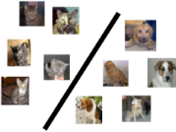
A Typical Supervised Learning Workflow
Note: This example is for the problem of binary classification, a supervised learning problem
“dog”
Labelled
Training
Data
“dog”
“dog”
“dog”
“cat”
“dog”
Can you think of a problem you would try to solve using supervised learning?
“cat”
“Feature”
Extraction
“dog”
ML Algorithm
(outputs a “model”)
“cat”
“cat”
“cat”
Feature extraction converts raw inputs to a numeric representation that the ML algo can understand and work with. More on feature extraction later.
“cat”
Predicted Label
(cat/dog)
Test
Image
“Feature”
Extraction
Cat vs Dog
Prediction model
https://www.pinclipart.com/, http://www.pngtree.com
Unsupervised Learning
Unsupervised Learning Framework

Slide 20
A Typical Unsupervised Learning Workflow
Note: This example is for the problem of data clustering, an unsupervised learning problem
Unlabeled
Data
ML Algorithm
(outputs a clustering)
“Feature”
Extraction
https://www.pinclipart.com/, http://www.pngtree.com
Reinforcement Learning
Reinforcement Learning Framework

Slide 21
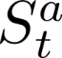
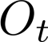
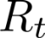
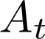

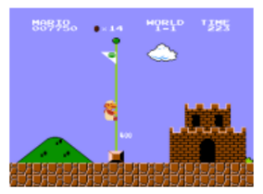
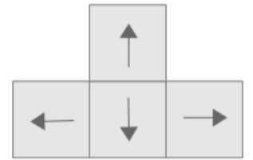

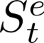
A Typical Reinforcement Learning Workflow
Wish to teach an agent optimal policy for some task
Agent does the following repeatedly
Senses/observes the environment
Takes an action based on its current policy
Receives a reward for that action
Updates its policy
Agent’s goal is to maximize its overall reward
Agent State
Observation
Action
Reward
There IS supervision, not explicit (as in Supervised Learning) but rather implicit (feedback based)
Environment State at time t
Geometric Perspective
Geometric Perspective Supervised Learning

Slide 22
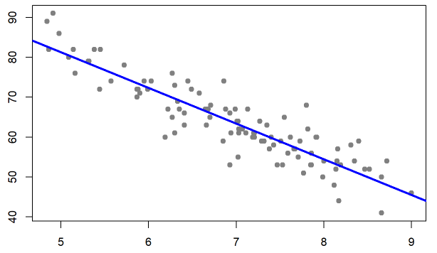
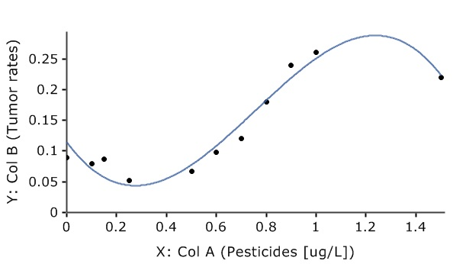
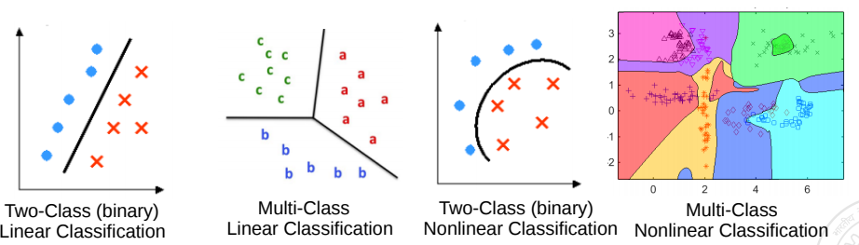
Geometric Perspective
Recall that feature extraction converts inputs into a numeric representation
Basic fact: Inputs in ML problems can often be represented as points or vectors in some vector space
Doing ML on such data can thus be seen from a geometric view
Regression: A supervised learning problem. Goal is to model the relationship between input (x) and real-valued output (y). This is a kind of a line or curve fitting problem
y: Grumpiness (scale of 0-100)
x: sleep hours
Classification: A supervised learning problem. Goal is to learn a to predict which of the two or more classes an input belongs to. Akin to learning linear/nonlinear separator for the inputs
Pic from: https://learningstatisticswithr.com/book/regression.html, https://maxstat.de/
Geometric Perspective
Geometric Perspective Unsupervised Learning

Slide 23
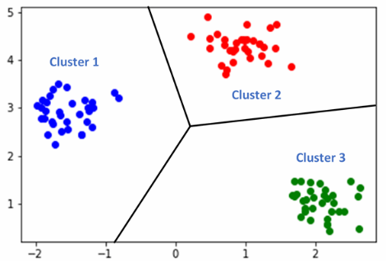

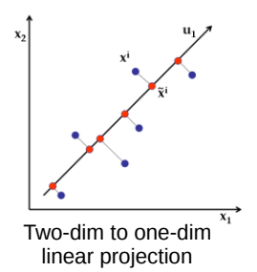
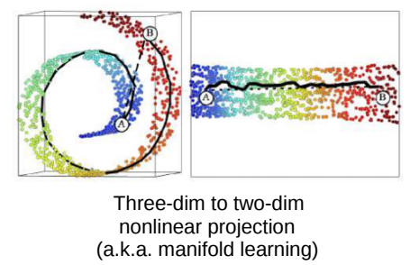
Geometric Perspective
Clustering looks like classification to me. Is there any difference?
Clustering: An unsupervised learning problem. Goal is to group inputs in a few clusters based on their similarities with each other
Yes. In clustering, we don’t know the labels. Goal is to separate them without any labeled “supervision”
Dimensionality Reduction: An unsupervised learning problem. Goal is to compress the size of each input without losing much information present in the data
Perspective as a Function Approximation

Slide 24
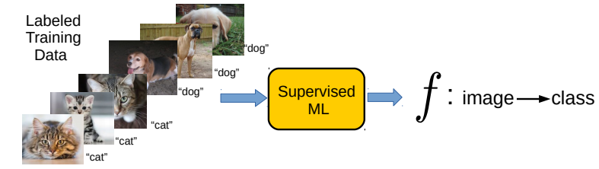
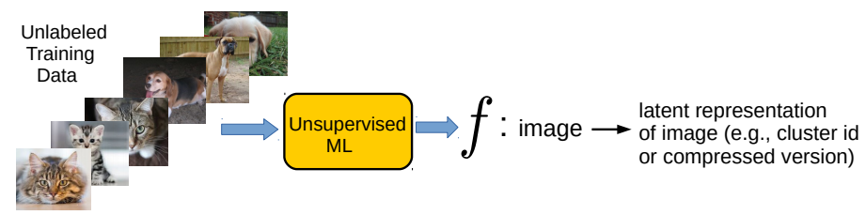
Perspective as function approximation
Supervised Learning (“predict output given input”) can be usually thought of as learning a function f that maps each input to the corresponding output
Unsupervised Learning (“model/compress inputs”) can also be usually thought of as learning a function f that maps each input to a compact representation
Reinforcement Learning can also be seen as doing function approximation
Harder since we don’t know the labels in this case
Persp as Prob estmn
Perspective as a Probability Estimation

Slide 25
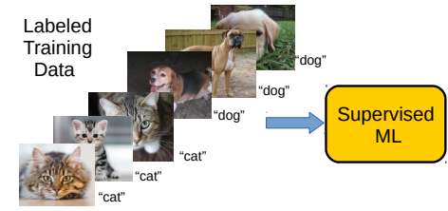
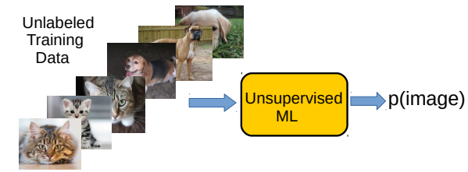
Perspective as probability estimation
Supervised Learning (“predict output given input”) can be thought of as estimating the conditional probability of each possible output given an input
Unsupervised Learning (“model/compress inputs”) can be thought of as estimating the probability density of the inputs
Reinforcement Learning can also be seen as estimating probability densities
p(label=“cat” | image)
Harder since we don’t know the labels in this case
Data and Features
Data and Feature

Slide 26
Data and Features
ML algorithms require a numeric feature representation of the inputs
Features can be obtained using one of the two approaches
Approach 1: Extracting/constructing features manually from raw inputs
Approach 2: Learning the features from raw inputs
Approach 1 is what we will focus on primarily for now
Approach 2 is what is followed in Deep Learning algorithms (will see in later)
Approach 1 is not as powerful as Approach 2 but still used widely
Feature Extrn from Text
Feature Extraction from Text Data

Slide 27
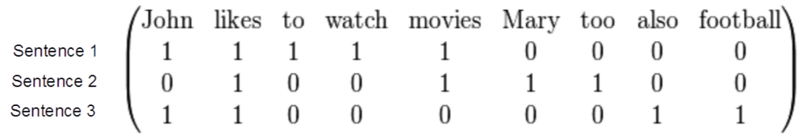
Example: Feature Extraction for Text Data
Consider some text data consisting of the following sentences:
John likes to watch movies
Mary likes movies too
John also likes football
Want to construct a feature representation for these sentences
Here is a “bag-of-words” (BoW) feature representation of these sentences
Each sentence is now represented as a binary vector (each feature is a binary value, denoting the presence or absence of a word). BoW is also called “unigram” representation.
BoW is just one of the many ways of doing feature extraction for text data. Not the most optimal one, and has various flaws (can you think of some?), but often works reasonably well
Feature Extn from Image
Feature Extraction from Image Data

Slide 28
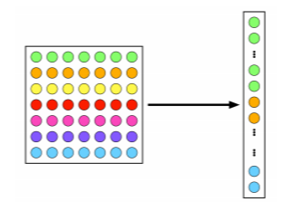

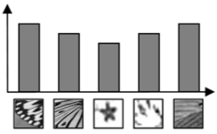
Example: Feature Extraction for Image Data
A very simple feature extraction approach for image data is flattening
Histogram of visual patterns is another popular feature extr. method for images
Many other manual feature extraction techniques developed in computer vision and image processing communities (SIFT, HoG, and others)
Flattening and histogram based methods destroy the spatial information in the image but often still work reasonably well
7x7 image
(49 pixels)
Vector of pixel
intensities
Pic credit: cat.uab.cat/Research/object-recognition
Feature Selection
Feature Selection

Slide 29
Feature Selection
Not all the extracted features may be relevant for learning the model (some may even confuse the learner)
Feature selection (a step after feature extraction) can be used to identify the features that matter, and discard the others, for more effective learning
Many techniques exist – some based on intuition, some based on algorithmic principles.
More common in supervised learning but can also be done for unsupervised learning
Age
Gender
Height
Weight
Eye color
Body-mass index (BMI)
Feature Scaling
Feature Scaling

Slide 30
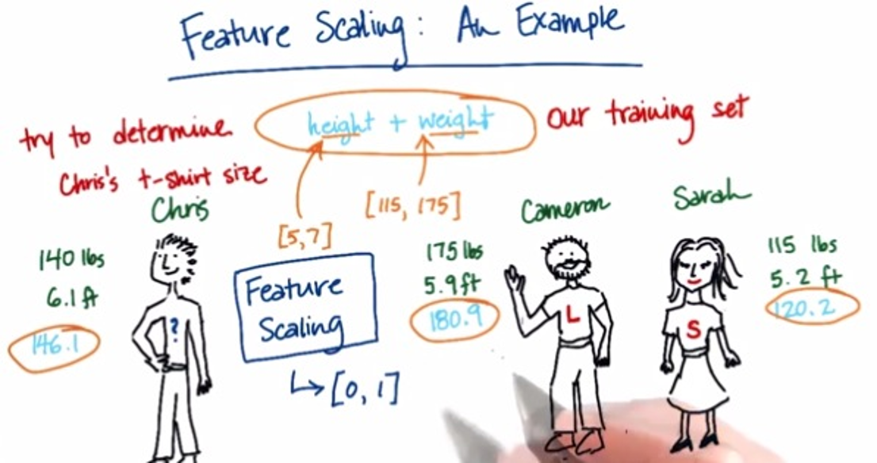
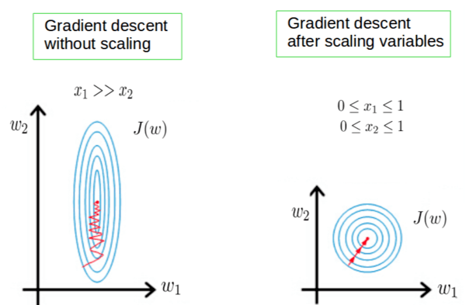
Some More Postprocessing: Feature Scaling
Even after feature selection, the features may not be on the same scale
This can be problematic when comparing two inputs – features that have larger scales may dominate the result of such comparisons
Therefore helpful to standardize the features (e.g., by bringing all of them on the same scale such as between 0 to 1)
Also helpful for stabilizing the optimization techniques used in ML algorithms.
Pic credit: https://becominghuman.ai/demystifying-feature-scaling-baff53e9b3fd, https://stackoverflow.com/
Common Notations
Motivation for AI

Slide 31
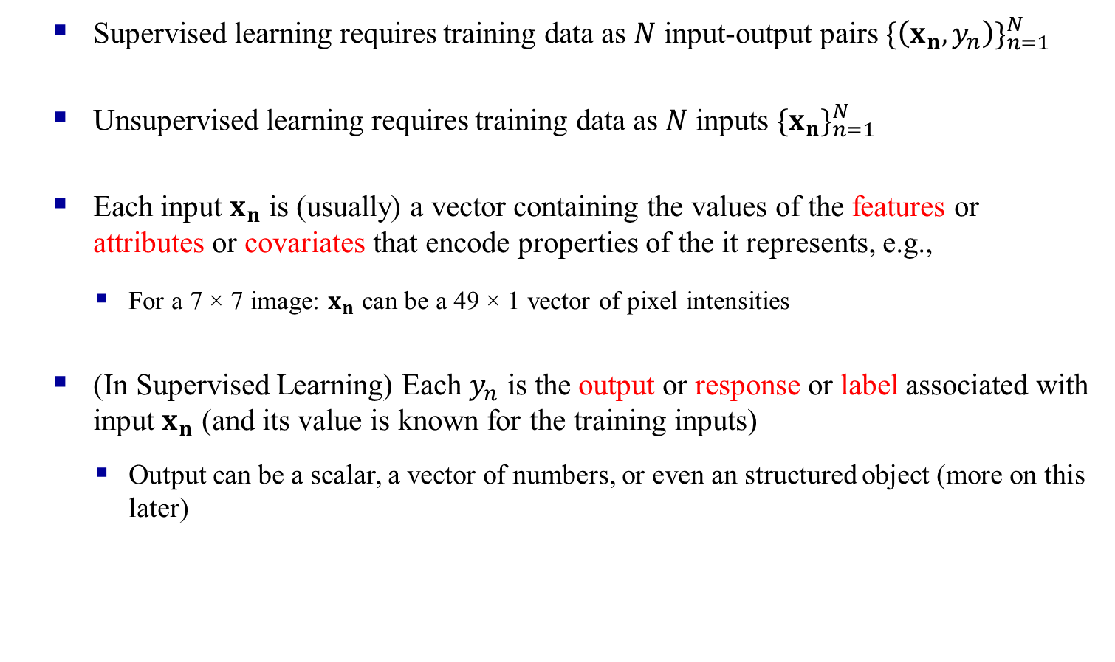

Some Notation/Nomenclature/Convention
Supervised learning requires training data as $N$ input-output pairs ${\{\left(x_{n},y_{n}\right)\}}_{n=1}^{N}$
Unsupervised learning requires training data as $N$ inputs ${\{x_{n}\}}_{n=1}^{N}$
Each input $x_{n}$ is (usually) a vector containing the values of the features or attributes or covariates that encode properties of the it represents, e.g.,
For a 7 × 7 image: $x_{n}$ can be a 49 × 1 vector of pixel intensities
(In Supervised Learning) Each $y_{n}$ is the output or response or label associated with input $x_{n}$ (and its value is known for the training inputs)
Output can be a scalar, a vector of numbers, or even an structured object (more on this later)
RL and other flavors of ML problems also use similar notation
Size or length of the input $x_{n}$ is commonly known as data/input dimensionality or feature dimensionality
Performance Measures
Linear Regression

Slide 32
Linear Regression
Linear Regression is a supervised machine learning model for regression problems.
Simple Linear Regression
Multiple Linear Regression
Ridge Regression
Lasso Regression
Elastic Net
Example

Slide 33
Linear Regression
Application
For data Fitting applications where we have to fit a straight line to a large data set.
y=mx+c
Where m=Slope Of Straight Line
X=Height c=Intercept y=Weight
W
E
I
G
H
T
vcv
Height
Error Calculation

Slide 34

Linear Regression
Error Calculation
The error E_{i}=(Actual Value – Predicted value)=$(Ti−yi)$
For making +ve= $Ei= (Ti−yi)2$[Error for i^{th} input instance]
W
E
I
G
H
T
vcv
Height
Why error calculation?

Slide 35
Linear Regression
Error Calculation
It is done to adjust the slope(m) and intercept for better fitting next time.
W
E
I
G
H
T
Height
Plotting the Error…

Slide 36
Plotting Error
Error →
M→
C →
2/6/2026
Dr. Sibarama Panigrahi, Dept. of CSE, NIT Rourkela
Differentiation Intuitive meani
36
Differentiation

Slide 37






Differentiation…
$$y=f(x)$$
How much does y change as x changes=
$$y=f(x)$$
y₂
(x2,y2)
$$\frac{dy}{dx}=\frac{df}{dx}=y^{′}=f^{′}$$
(x1,y1)
$$θ$$
y₁
$x$ ------→
x₁
x₂
$$\frac{dy}{dx}=\lim_{Δx→0}{\frac{Δy}{Δx}}$$
2/6/2026
Dr. Sibarama Panigrahi, Dept. of CSE, NIT Rourkela
What happens in Differentiation
37
What happens in Differentiation?

Slide 38




Differentiation…
$$\frac{dy}{dx}=\lim_{Δx→0}{\frac{Δy}{Δx}}$$
As $Δx →0$ we obtain a
tangent at x.
$\frac{dy}{dx}=tan(θ)$=slope of the tangent at x=x₁
$\frac{dy}{dx}=$ Slope of the tangent to x-axis at x=x₁
$$y=f(x)$$
y₂
y₁
$$θ$$
$x$ →
x₁
x₂
2/6/2026
Dr. Sibarama Panigrahi, Dept. of CSE, NIT Rourkela
Different cases of angle theta
38
Different cases based on angle..

Slide 39


Differentiation…
$0<θ<90 tan(θ)$= +ve
90 tan(90)=Undefined
$$y=f(x)$$
$$θ$$
$x$ →
x₁
2/6/2026
Dr. Sibarama Panigrahi, Dept. of CSE, NIT Rourkela
When theta > 90
39
When theta > 90

Slide 40



Differentiation…
$θ>90 tan(θ)$= - ve
$$y=f(x)$$
$$θ$$
$x$ →
x₁
2/6/2026
Dr. Sibarama Panigrahi, Dept. of CSE, NIT Rourkela
When theta=0
40
When theta=0

Slide 41

Differentiation…
$θ=0 tan(θ)$= 0
$$y=f(x)$$
$x$ →
x₁
2/6/2026
Dr. Sibarama Panigrahi, Dept. of CSE, NIT Rourkela
Maxima and Minima
41
When theta=0

Slide 42

Differentiation…
$θ=0 tan(θ)$= 0
$$y=f(x)$$
Maxima
$x$ →
x₁
Minima
Note: At minima and Maxima the Slope is 0 ➔ tan($θ$)=0 ➔ $\frac{dy}{dx}$ = 0
2/6/2026
Dr. Sibarama Panigrahi, Dept. of CSE, NIT Rourkela
Distinguishing b/w maxi & Mini
42
Error Function with a Minima

Slide 43
Error Function with Minima and No Maxima
$$y=f(x)$$
$x$ →
Minima
2/6/2026
Dr. Sibarama Panigrahi, Dept. of CSE, NIT Rourkela
Error Fun with Maxima…
43
Error Function with a Single Maxima

Slide 44
Error Function with a Maxima and No Minima
$$y=f(x)$$
Maxima
$x$ →
2/6/2026
Dr. Sibarama Panigrahi, Dept. of CSE, NIT Rourkela
Error Fun: No Max No Min
44
Error Function with No Maxima and No Minima

Slide 45
Error Function without a Maxima and Minima
$$y=f(x)$$
$x$ →
2/6/2026
Dr. Sibarama Panigrahi, Dept. of CSE, NIT Rourkela
Error Fun: Mult Max Mult Min
45
Error Function with Multiple Maxima and Minima

Slide 46
Error Function with multiple Maxima and Minima
$$y=f(x)$$
$x$ →
Global Minima
Local Minima
2/6/2026
Dr. Sibarama Panigrahi, Dept. of CSE, NIT Rourkela
Training a Single Neuron Model
46
Linear Regression

Slide 47











Linear Regression: Pictorially
Linear regression is like fitting a line or (hyper)plane to a set of points
The line/plane must also predict outputs the unseen (test) inputs well
$$\left[\begin{aligned}z_{1} \\ z_{2}\end{aligned}\right]=φ(x)$$
What if a line/plane doesn’t model the input-output relationship very well, e.g., if their relationship is better modeled by a nonlinear curve or curved surface?
Original (single) feature
Nonlinear curve needed
Two features
Can fit a plane (linear)
(Output $y$)
(Output $y$)
No. We can even fit a curve using a linear model after suitably transforming the inputs
$$y≈w^{⊤}φ(x)$$
Do linear models become useless in such cases?
Input $x$ (single feature)
(Feature 2)
(Feature 1)
The transformation $φ\left(.\right)$ can be predefined or learned (e.g., using kernel methods or a deep neural network based feature extractor). More on this later
Linear Regression

Slide 48

Simplest Possible Linear Regression Model
This is the base model for all statistical machine learning
x is a one feature data variable
y is the value we are trying to predict
The regression model is
Two parameters to estimate – the slope of the line w₁ and the y-intercept w₀
ε is the unexplained, random, or error component.
Linear Regression

Slide 49

Solving the regression problem
We basically want to find {w0, w1} that minimize deviations from the predictor line
How do we do it?
Iterate over all possible w values along the two dimensions?
Same, but smarter? [next class]
No, we can do this in closed form with just plain calculus
Very few optimization problems in ML have closed form solutions
The ones that do are interesting for that reason
Linear Regression

Slide 50



Parameter estimation via calculus
We just need to set the partial derivatives to zero (full derivation)
Simplifying
Linear Regression

Slide 51








More generally
Given: Training data with $N$ input-output pairs ${{\{(x}_{n},y_{n})\}}_{n=1}^{N}$, $x_{n}∈ℝ^{D}$, $y_{n}∈ℝ$
Goal: Learn a model to predict the output for new test inputs
Assume the function that approximates the I/O relationship to be a linear model
Let’s write the total error or “loss” of this model over the training data as
Can also write all of them compactly using matrix-vector notation as $y≈Xw$
$$y_{n}≈f\left(x_{n}\right)= w^{⊤}x_{n} (n=1,2,…,N)$$
Goal of learning is to find the $w$ that minimizes this loss + does well on test data
$L\left(w\right)= \sum_{n=1}^{N}{ℓ(y_{n}, }$ $w^{⊤}x_{n}$)
$ℓ(y_{n},w^{⊤}x_{n})$ measures the
prediction error or “loss” or “deviation” of the model on a single training input ${(x}_{n},y_{n})$
Linear Regression

Slide 52






Linear Regression with Squared Loss
52
In this case, the loss func will be
Let us find the $w$that optimizes (minimizes) the above squared loss
We need calculus and optimization to do this!
The LS problem can be solved easily and has a closed form solution
In matrix-vector notation, can write it compactly as ${\left\|y−Xw\right\|}_{2}^{2}={(y−Xw)}^{⊤}(y−Xw$)
$L\left(w\right)=$ $\sum_{n=1}^{N}{{(y_{n}−w^{⊤}x_{n})}^{2}}$
The “least squares” (LS) problem Gauss-Legendre, 18th century)
$w_{LS}$= ${\text{arg} \text{min}}_{w} L\left(w\right)={\text{arg} \text{min}}_{w}\sum_{n=1}^{N}{{(y_{n}−w^{⊤}x_{n})}^{2}}$
Link to a nice derivation
$w_{LS}$= ${(\sum_{n=1}^{N}{x_{n} x_{n}^{⊤}) }}^{−1}(\sum_{n=1}^{N}{y_{n}x_{n}})$
$${=(X^{⊤}X)}^{−1}X^{⊤}y$$
$D×D$ matrix inversion – can be expensive. Ways to handle this.
Linear Regression

Slide 53














Alternative loss functions
Choice of loss function usually depends on the nature of the data. Also, some loss functions result in easier optimization problem than others
Many possible loss functions for regression problems
Squared loss
Loss
$${(y_{n}−f(x_{n}))}^{2}$$
Absolute loss
Loss
$${|y}_{n}−f\left(x_{n}\right)|$$
Very commonly used for regression. Leads to an easy-to-solve optimization problem
Grows more slowly than squared loss. Thus better suited when data has some outliers (inputs on which model makes large errors)
${y_{n}− f(x}_{n}$)
${y_{n}− f(x}_{n}$)
Loss
Huber loss
Loss
$${|y}_{n}−f\left(x_{n}\right)|−ε$$
Squared loss for small errors (say up to $δ$); absolute loss for larger errors. Good for data with outliers
$ε$-insensitive loss
(a.k.a. Vapnik loss)
Note: Can also use squared loss instead of absolute loss
Zero loss for small errors (say up to $ε$); absolute loss for larger errors
$$−δ$$
$$δ$$
${y_{n}− f(x}_{n}$)
$$−ε$$
$$ε$$
${y_{n}− f(x}_{n}$)
Linear Regression

Slide 54





How do we ensure generalization?
We minimized the objective $L\left(w\right)=$ $\sum_{n=1}^{N}{{(y_{n}−w^{⊤}x_{n})}^{2}}$ w.r.t. $w$ and got
Problem: The matrix $X^{⊤}X$ may not be invertible
This may lead to non-unique solutions for $w_{opt}$
Problem: Overfitting since we only minimized loss defined on training data
Weights $w=[w_{1},w_{2},…,w_{D}]$ may become arbitrarily large to fit training data perfectly
Such weights may perform poorly on the test data however
One Solution: Minimize a regularized objective $L\left(w\right)+$ $λ R\left(w\right)$
The reg. will prevent the elements of $w$ from becoming too large
Reason: Now we are minimizing training error + magnitude of vector $w$
$w_{LS}$= ${(\sum_{n=1}^{N}{x_{n} x_{n}^{⊤}) }}^{−1}(\sum_{n=1}^{N}{y_{n}x_{n}})$
$${=(X^{⊤}X)}^{−1}X^{⊤}y$$
$R\left(w\right)$is called the Regularizer and measures the “magnitude” of $w$
$λ≥0$ is the reg. hyperparam. Controls how much we wish to regularize (needs to be tuned via cross-validation)
Linear Regression

Slide 55







Regularized Least Squares (a.k.a. Ridge Regression)
Recall that the regularized objective is of the form $L_{reg}(w)= L\left(w\right)+λ R\left(w\right)$
One possible/popular regularizer: the squared Euclidean ($ℓ_{2}$ squared) norm of $w$
With this regularizer, we have the regularized least squares problem as
Proceeding just like the LS case, we can find the optimal $w$ which is given by
$$R\left(w\right)= {\left\|w\right\|}_{2}^{2}= w^{⊤}w$$
$${\text{= }\text{arg} \text{min}}_{w}\sum_{n=1}^{N}{{(y_{n}−w^{⊤}x_{n})}^{2}}+λw^{⊤}w$$
$w_{ridge}\text{=} {\text{arg} \text{min}}_{w} L\left(w\right)$ + $λ R\left(w\right)$
Why is the method called “ridge” regression
Look at the form of the solution. We are adding a small value $λ$ to the diagonals of the DxD matrix $X^{⊤}X$ (like adding a ridge/ mountain to some land)
$w_{ridge}$= ${(\sum_{n=1}^{N}{x_{n} x_{n}^{⊤}+λI_{D}) }}^{−1}(\sum_{n=1}^{N}{y_{n}x_{n}})$
$${=(X^{⊤}X+λI_{D})}^{−1}X^{⊤}y$$
Linear Regression

Slide 56









A closer look at ℓ₂ regularization
The regularized objective we minimized is
Minimizing $L_{reg}\left(w\right)$w.r.t. $w$ gives a solution for $w$ that
Keeps the training error small
Has a small $ℓ_{2}$ squared norm $w^{⊤}w$ = $\sum_{d=1}^{D}{w_{d}^{2}}$
Small entries in $w$ are good since they lead to “smooth” models
Remember – in general, weights with large magnitude are bad since they can cause overfitting on training data and may not work well on test data
$$L_{reg}\left(w\right)=\sum_{n=1}^{N}{{(y_{n}−w^{⊤}x_{n})}^{2}}+λw^{⊤}w$$
Good because, consequently, the individual entries of the weight vector $w$ are also prevented from becoming too large
Not a “smooth” model since its test data predictions may change drastically even with small changes in some feature’s value
A typical $w$ learned without $ℓ_{2}$ reg.
$$x_{n}=$$
1.2
0.5
2.4
0.3
0.8
0.1
0.9
2.1
$$y_{n}=0.8$$
3.2
1.8
1.3
2.1
10000
2.5
3.1
0.1
$$x_{m}=$$
$$y_{m}=100$$
1.2
0.5
2.4
0.3
0.8 $+ ε$
0.1
0.9
2.1
Just to fit the training data where one of the inputs was possibly an outlier, this weight became too big. Such a weight vector will possibly do poorly on normal test inputs
Exact same feature vectors only differing in just one feature by a small amount
Very different outputs though (maybe one of these two training ex. is an outlier)
Linear Regression

Slide 57








Other Ways to Control Overfitting
Note that optimizing loss functions with such regularizers is usually harder than ridge reg. but several advanced techniques exist (we will see some of those later)
57
Use a regularizer $R\left(w\right)$ defined by other norms, e.g.,
Use non-regularization based approaches
Early-stopping (stopping training just when we have a decent val. set accuracy)
Dropout (in each iteration, don’t update some of the weights)
Injecting noise in the inputs
$ℓ_{1}$ norm regularizer
Use them if you have a very large number of features but many irrelevant features. These regularizers can help in automatic feature selection
$${\left\|w\right\|}_{1}= \sum_{d=1}^{D}{|w_{d}|}$$
When should I used these regularizers instead of the $ℓ_{2}$ regularizer?
$${\left\|w\right\|}_{0}=\#nnz(w)$$
Using such regularizers gives a sparse weight vector $w$ as solution
sparse means many entries in $w$ will be zero or near zero. Thus those features will be considered irrelevant by the model and will not influence prediction
$ℓ_{0}$ norm regularizer (counts number of nonzeros in $w$)
All of these are very popular ways to control overfitting in deep learning models. More on these later when we talk about deep learning
Logistic Regression

Slide 58
Logistic Regression
Logistic Regression is a supervised machine learning algorithm used for classification problems.
Unlike linear regression, which predicts continuous values, it predicts the probability that an input belongs to a specific class.
Types of LR

Slide 59
Logistic Regression
Binomial Logistic Regression: This type is used when the dependent variable has only two possible categories. Examples include Yes/No, Pass/Fail or 0/1. It is the most common form of logistic regression and is used for binary classification problems.
Multinomial Logistic Regression: This is used when the dependent variable has three or more possible categories that are not ordered. For example, classifying animals into categories like "cat," "dog" or "sheep." It extends the binary logistic regression to handle multiple classes.
Ordinal Logistic Regression: This type applies when the dependent variable has three or more categories with a natural order or ranking. Examples include ratings like "low," "medium" and "high." It takes the order of the categories into account when modeling.
Assumptions of LR

Slide 60
Logistic Regression
Assumptions:
Independent observations: Each data point is assumed to be independent of the others means there should be no correlation or dependence between the input samples.
Binary dependent variables: It takes the assumption that the dependent variable must be binary, means it can take only two values. For more than two categories SOFTMAX functions are used.
Linearity relationship between independent variables and log odds: The model assumes a linear relationship between the independent variables and the log odds of the dependent variable which means the predictors affect the log odds in a linear way.
No outliers: The dataset should not contain extreme outliers as they can distort the estimation of the logistic regression coefficients.
Large sample size: It requires a sufficiently large sample size to produce reliable and stable results.
How it works

Slide 61






Logistic Regression
Performance Measures

Slide 62
Performance Measures
Performance measures are used to evaluate the performance of ML models for a specific problem.
Classification Problem Performance Measures
Regression Problem Performance Measures
Classificn Perf Measur
Confusion Matrix

Slide 63

Classification Problem Performance Measures
Confusion Matrix
True Positive (TP): Both Actual & Predicted Values are Positive
True Negative (TN): Both Actual & Predicted Values are Negative
False Positive (FP): Actual Negative & Predicted Positive
False Negative (FN): Actual Positive & Predicted Negative
Accuracy
Accuracy

Slide 64

Classification Problem Performance Measures
Accuracy: It can also be calculated in terms of positives and negatives for binary classification.
It doesn’t grant us much information regarding the distribution of false positives and false negatives.
Shouldn’t be used when the dataset is unbalanced.
Precision
Precision

Slide 65

Classification Problem Performance Measures
Precision: It is the ratio of True Positives to all the positives predicted by the model.
Precision measures the model's ability to correctly identify positive instances.
It is useful for the skewed and unbalanced dataset.
The more False positives the model predicts, the lower the precision.
Example: A medical diagnosis model with 85% precision means that out of all the patients it predicted to have the disease, 85% actually had the disease.
Recall
Recall

Slide 66

Classification Problem Performance Measures
Recall or Sensitivity or True Positive Rate(TPR): It is the ratio of true positives to all the positives in your dataset.
It measures the model’s ability to detect positive samples.
The more false negatives the model predicts, the lower the recall.
Example: A cancer detection system with 95% recall means that it correctly identified 95% of cancer cases.
F1 Score
F1 Score

Slide 67

Classification Problem Performance Measures
F1-score or F-measure: It is a single metric that combines both Precision and Recall.
The F1-score is a harmonic mean of precision and recall, providing a single metric that balances both aspects
The higher the F1 score, the better is the performance of our model. The range for F1-score is [0,1].
A spam filtering model with an F1-score of 0.8 indicates a good balance between precision and recall.
ROC Curve
ROC Curve

Slide 68


Classification Problem Performance Measures
ROC curve (Receiver Operating Characteristic curve):
It is a way to visualize the tradeoff between the True Positive Rate (TPR) and False Positive Rate(FPR) using different decision thresholds.
Regression Perf Meas
Regression Performance Measures

Slide 69


Regression Problem Performance Measures
where $y_{i}$ and $\hat{y_{i}}$ denote the ith actual and Predicted value, n denotes the number of observations. Lower the value better the forecasts.
Decision Tree
Handling Imbalanced Dataset

Slide 70
Handling Imbalanced Datasets: Strategies and Metrics
Imbalanced datasets present a challenge for machine learning models, as the model may become biased towards the majority class. Techniques like oversampling, undersampling, and cost-sensitive learning are employed to address this imbalance.
Oversampling: Duplicates instances of the minority class to balance the dataset.
Undersampling: Removes instances of the majority class to create a more balanced dataset.
Cost-Sensitive Learning: Assigns different costs to misclassifications, penalizing errors made on the minority class more heavily.
Evaluating Model Performance

Slide 71
Evaluating Model Performance: Train, Validation, and Test Sets
To evaluate a machine learning model's performance accurately, it is essential to split the dataset into training, validation, and test sets. This ensures that the model is trained on one set of data, its performance is evaluated on a separate validation set, and its final performance is measured on an unseen test set.
Training Set: Used to train the model.
Validation Set: Used to tune hyperparameters and select the best model.
Test Set: Used to assess the final performance of the selected model on unseen data.
Thank you

Slide 72

Thank You
For Your Valuable Time.

